Slide 1
XPC Chart Review Simulator: Abstract to Concrete.
Morris Aguilar, Ph.D.
Generative AI (GenAI) Fellow at XPC
04-14-2025

Slide 2
Completed Objectives Since Last Meeting.
Prototyping how the user/learner interacts with the feedback.
GenAI outputs are delivered to the user via their browser.
Dynamic assembly of HTML from the JSON outputs.
2. Partial completion of the drug price list.

Slide 3





Focusing on Prototyping the Browser Ready Chart Review Contents.
Local
Python Code API
Chart
Review
Query
OpenAI
API
JSON
Format
Output
Local
Python Code
Browser Ready
Chart Review
Document

Slide 4
Automatically Creating the HTML from the GenAI JSON Output with an HTML Template.
</HTML>
HTML
Template
+
JSON
Format
Output
Browser Ready
Chart Review
Document
Local
Python Code

Slide 5
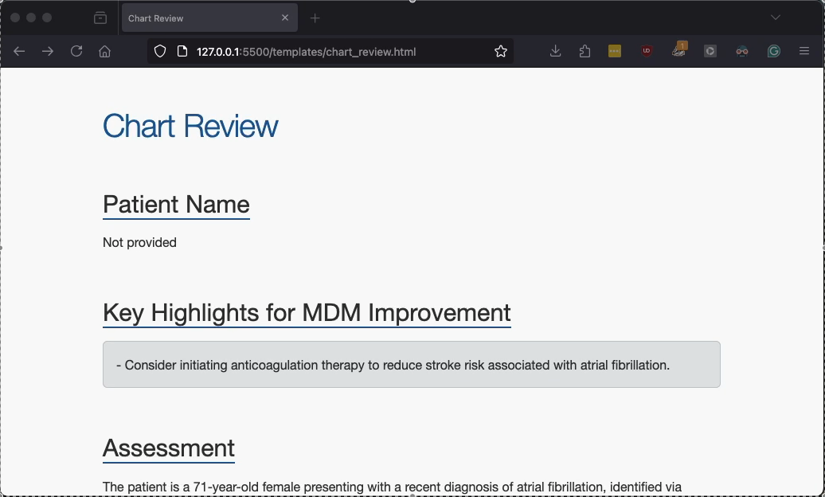
Chart Review Demo 1

Slide 6
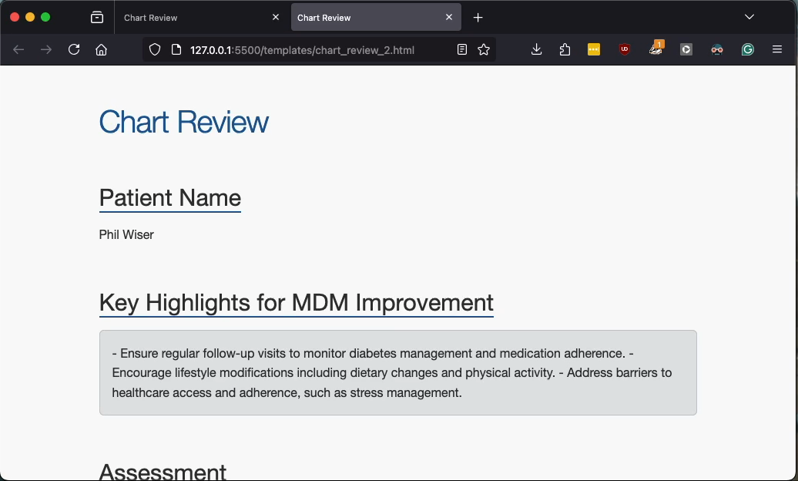
Chart Review Demo 2

Slide 7
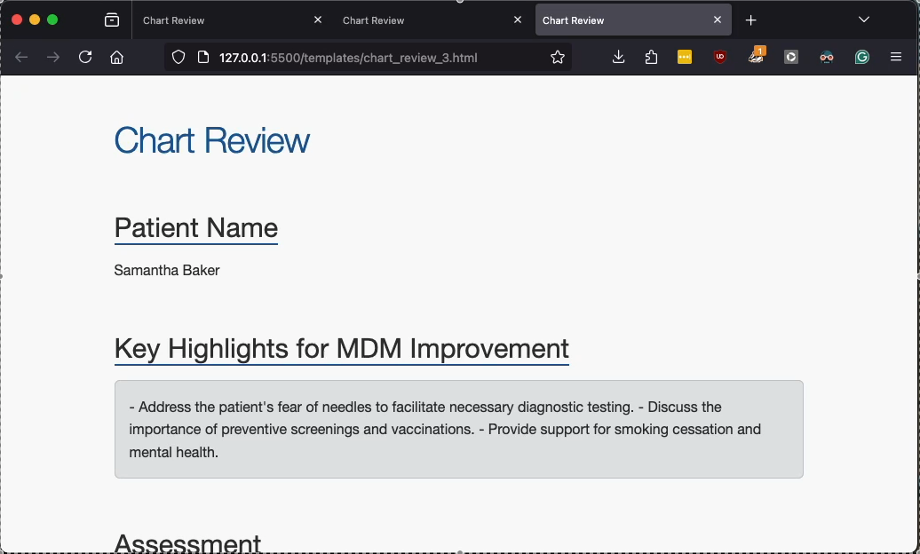
Chart Review Demo 2

Slide 8
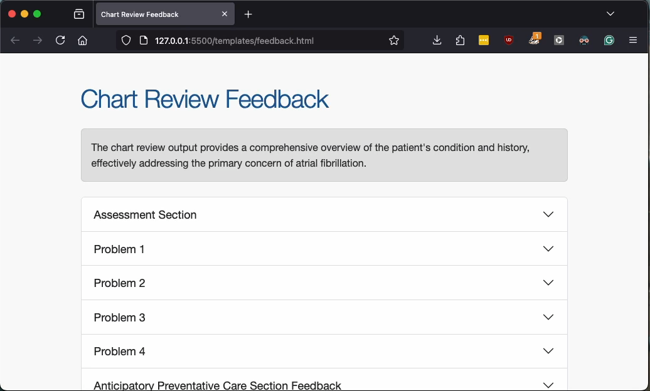
Feedback Demo 1

Slide 9
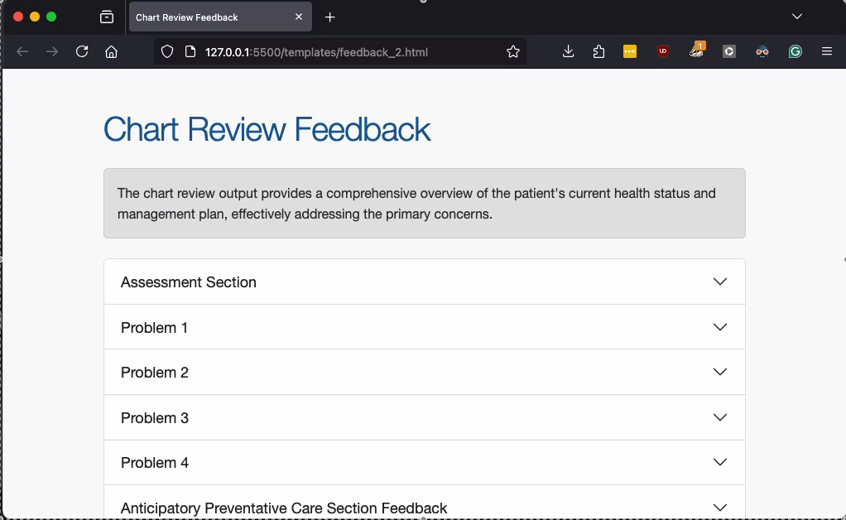
Feedback Demo 2

Slide 10
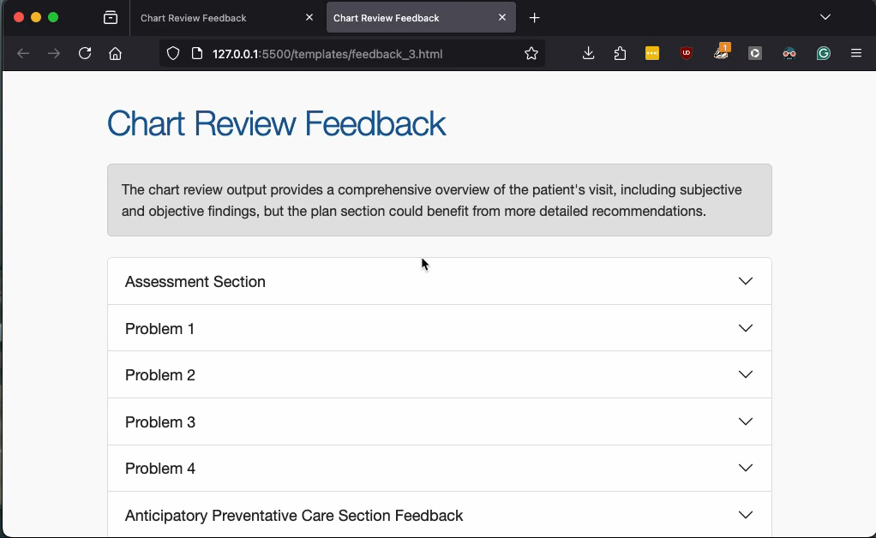
Feedback Demo 3

Slide 11
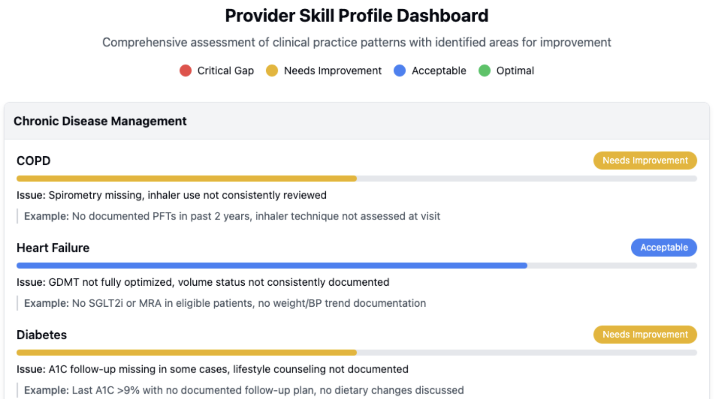
The Prototypes Presented Demonstrate the Feasibility of a Bulk Chart Review Dashboard.
Source: Paulius Mui, M.D., XPC

Slide 12
Practical Next Steps:
Bulk chart review dashboard
Integrating the cost-effective medication management analysis.
AWS Implementation Bedrock.
Notes:
User might want pdf
One to one comparion of bill moore

